Slide 1
Mo’ Truth Tables
Part II

Slide 2
Let’s do some more truth tables…
This time we will do:

Slide 3
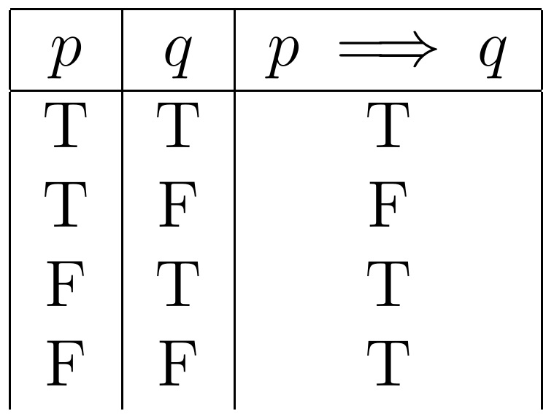
Table:

Slide 4
Table:
Remember the lying politician!!!

Slide 5
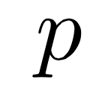
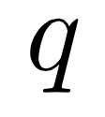
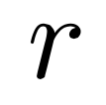
Free propositions (the smallest of the small)
Last time we saw we need to run through every combination of true and false of our “free” propositions that is

Slide 6
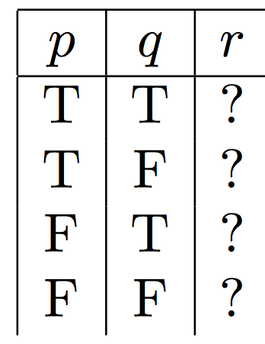
No problem!
2 choices!
repeat this twice

Slide 7
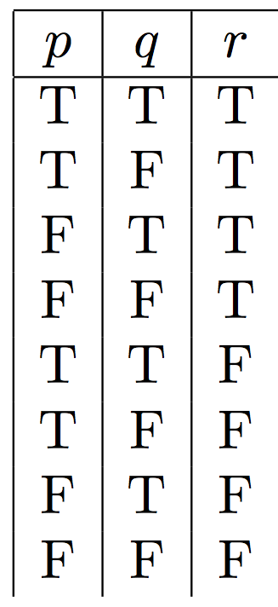

Slide 8
Break down the expression
To see when this expression is true it is most convenient to break down the proposition into smaller pieces
This is a NEW proposition

Slide 9
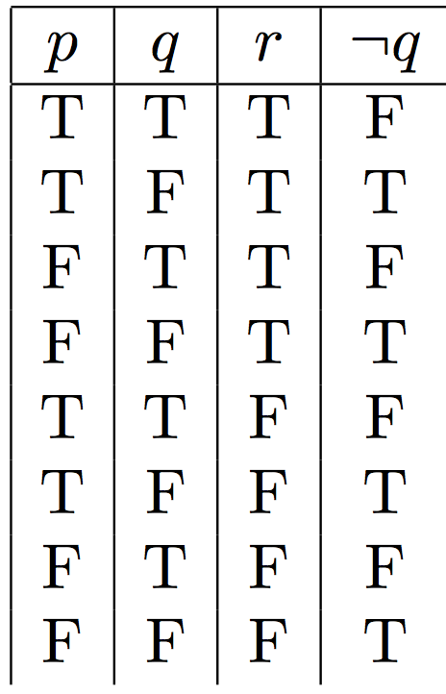

Slide 10
Break down the expression
We continue to break it down!
This is a NEW proposition

Slide 11
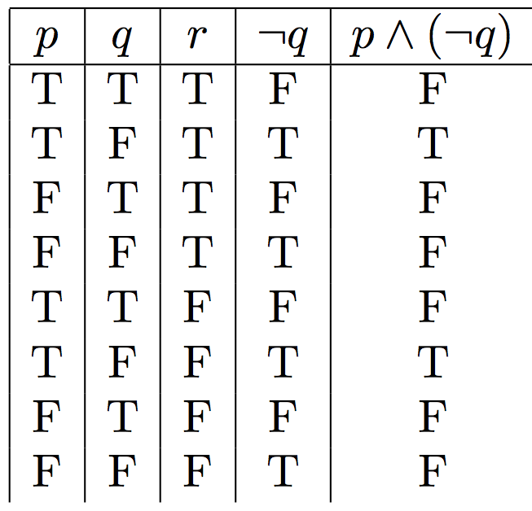

Slide 12
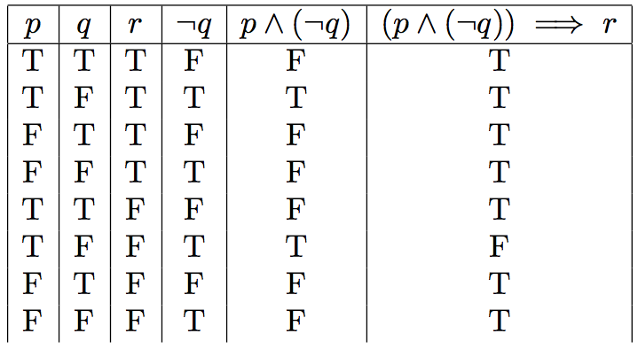
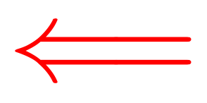

Slide 13
Free propositions (the smallest of the small)
So how do we start this one?

Slide 14
2 choices!
repeat this twice

Slide 16
Break down the expression
To see when this expression is true it is most convenient to break down the proposition into smaller pieces
This is a NEW proposition

Slide 17
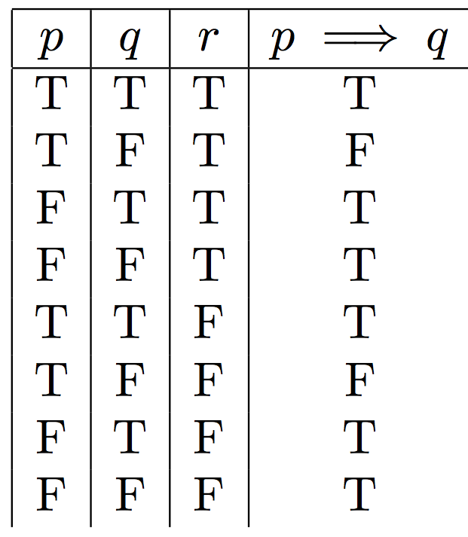

Slide 18
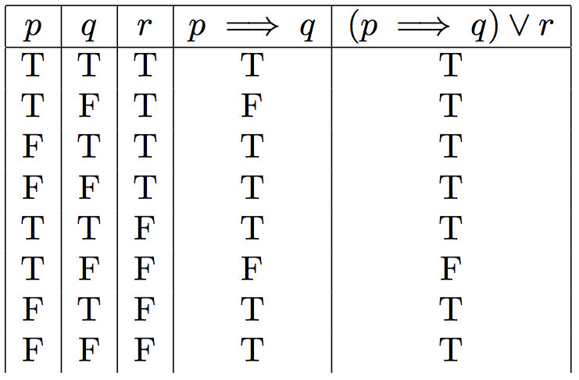

Slide 19
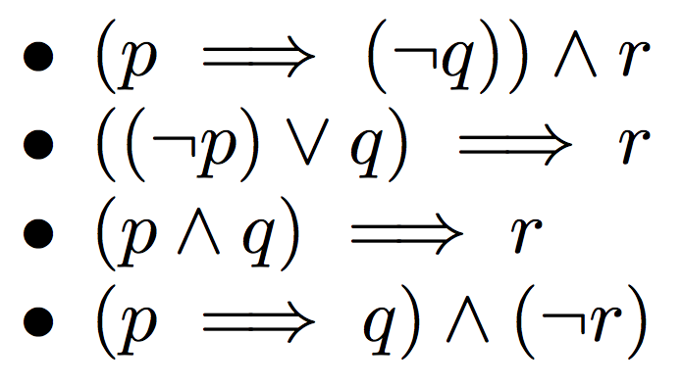
Group Work (teaching method 3)
Construct a truth table for the following:
(RC)
(GR)
(HP)
(SL)

